Slide 1
Question 2
The type of a hash table H under closed addressing is an array of list references, and under open addressing is an array of keys. Assume a key requires one “word” of memory and a linked list node requires two words, one for the key and one for a list reference. Consider each of these load factors for closed addressing: 0.5, 1.0, 2.0.
Estimate the total space requirement, including space for lists, under closed addressing, and then, assuming that the same amount of space is used for an open addressing hash table, what are the corresponding load factors under open addressing?

Slide 2
Hash table with closed addressing
Hash table size (number of table entries): h
Load factor: f
Number of nodes: fh
Space
The list of references: h words
The nodes: 2fh words (2 words per node: one for the key and the other for the reference of the list node)
Total space: (2f+1)h words
h
fh nodes

Slide 3

Hash table with open addressing
The same amount of space as closed addressing: (2f+1)h words
The number of table entries: (2f+1)h (1 word per entry)
The same number of nodes as closed addressing: fh nodes
Load factor: $\frac{\# of nodes}{\# of table entries}=\frac{fh}{\left(2f+1\right)h}=\frac{f}{2f+1}$
Table size (closed addressing) | Load factor (closed addressing) | # of nodes (closed addressing) | Memory (words) | Table size (open addressing) | # of nodes (open addressing) | Load factor (open addressing)
h | f | fh | (2f+1)h | (2f+1)h | fh | f/(2f+1)
h | 0.5 | 0.5h | 2h | 2h | 0.5h | 0.25
h | 1 | h | 3h | 3h | h | 1/3
h | 2 | 2h | 5h | 5h | 2h | 0.4

Slide 4
Question 3
Consider a hash table of size n using open address hashing and linear probing.
(i) Suppose that the hash table has a load factor of 0.5, describe, with a diagram of the hash table, the best-case and worst-case scenarios for the key distribution in the table.
(ii) For each of the two scenarios, compute the average-case time complexity in terms of the number of key comparisons when inserting a new key. You may assume equal probability for the new key to be hashed into each of the n slots.

Slide 5
In the best scenario, each of the n/2 elements is hashed to a unique index in the hash table, and the elements are distributed evenly into the n slots.
Since no collision occurs, inserting an element into the table requires 1 comparison only.
Assuming equal probability for a key to be hashed into each of the n slots,
 | Hash Table
0
1
2
3
n-1
n

Slide 6
In the worst scenario, the hash function returns the same hash value for all the elements. Without loss of generality, we assume the hash value is 0.
When collision occurs, we use linear probing to find the next open index.
Element 1: 1 comparison
Element 2: 2 comparisons
…
Element i: i comparisons
The n/2 elements are stored in consecutive slots in the hash table.
Assuming equal probability for a key to be hashed into each of the n slots,
 | Hash Table
0
1
2
3
n/2-1
n/2
n-1
n

Slide 7
Question 2
Use the divide and conquer approach to design an algorithm that finds both the largest and the smallest elements in an array of n integers. Show that your algorithm does at most roughly 1.5n comparisons of the elements. Assume n = 2^{k}.

Slide 8


Binary search & cyclically sorted array (T2-Q1)
Solve (problem of size n)
{
if (n is small enough)
{
find the solution and return;
}
divide the input array into two halves
use a problem-dependent strategy to determine which half we should go in the recursive call
Solve (problem of size n/2)
}
$$T_{n}=T_{n/2}+b$$
$$T_{n}=O(\log_{2}n)$$

Slide 9

Divide-and-conquer (MergeSort, QuickSort)
Solve (problem of size n)
{
if (n is small enough)
{
find the solution and return;
}
divide the input array into two halves
s₁ = Solve (problem of size n/2) // solve the first sub-problem
s₂ = Solve (problem of size n/2) // solve the second sub-problem
combine s₁ and s₂ to form the solution of the original problem
}
$$T_{n}=2T_{n/2}+b$$

Slide 10
Question 2
void findMinMax(int[] ar, int start, int end, int[] minMax)
// minMax is an array of two integers to return the minimum
// and maximum found
{
int tempMinMax1[] = new int[2];
int tempMinMax2[] = new int[2];
int mid;
if (start == end) { // one element array
minMax[0] = ar[start];
minMax[1] = ar[start];
}
else if (end – start == 1) { // two element array if (ar[start] > ar[end]) {
minMax[1] = ar[start];
minMax[0] = ar[end];
} else {
minMax[0] = ar[start];
minMax[1] = ar[end];
}
}

Slide 11
else { // array longer than two elements
mid = (start + end)/2;
findMinMax(ar, start, mid, tempMinMax1);
findMinMax(ar, mid+1, end, tempMinMax2);
if (tempMinMax1[0] < tempMinMax2[0])
minMax[0] = tempMinMax1[0];
else minMax[0] = tempMinMax2[0];
if (tempMinMax1[1] > tempMinMax2[1])
minMax[1] = tempMinMax1[1];
else minMax[1] = tempMinMax2[1];
}
}

Slide 12
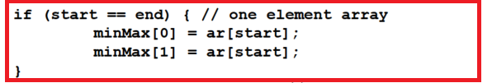
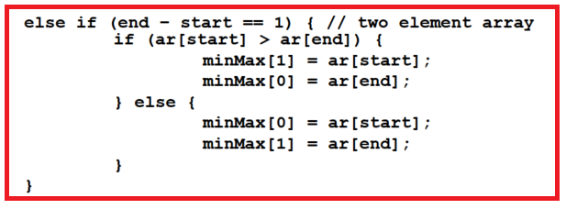



Complexity Analysis
Denote by $T_{n}$ the number of comparisons
Step 1) examine the base case(s):
$$T_{1}=0$$
$$T_{2}=1$$

Slide 13
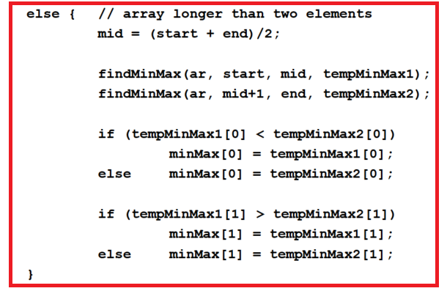


Step 2) write the recurrence equation:
We need to determine the coefficients A and B, and the sub-script k
A: the number of recursive calls
k: the size of sub-problems
B: the extra number of comparisons
$$T_{n}=AT_{k}+B$$
$$T_{n}=2T_{n/2}+2$$

Slide 14











Step 3) solve the recurrence equation:
$$T_{n}=2T_{n/2}+2$$
$$T_{1}=0$$
$$T_{2}=1$$
Assume $n=2^{k}$
Rewrite the equation using index k $T_{2^{k}}=2T_{2^{k−1}}+2$
Reduce the index until reaching the base case
$$T_{2^{k}}=2T_{2^{k−1}}+2$$
$$T_{2^{k−1}}=2T_{2^{k−2}}+2$$
$$T_{2^{k−2}}=2T_{2^{k−3}}+2$$
$k−1$ equations
$$……$$
$$T_{2^{2}}=2T_{2^{1}}+2$$
However, directly adding these equations won’t cancel out the intermediate terms

Slide 15






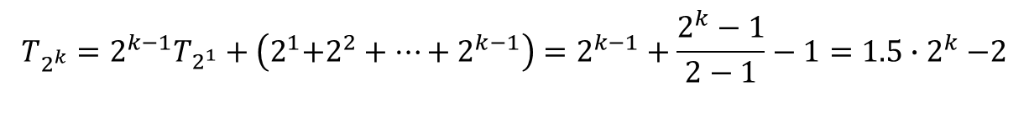










Multiply the i-th equation by $2^{i−1}$
$$T_{2^{k}}=2T_{2^{k−1}}+2$$
$${2^{0}T}_{2^{k}}=2^{1}T_{2^{k−1}}+2^{1}$$
$$T_{2^{k−1}}=2T_{2^{k−2}}+2$$
$$2^{1}T_{2^{k−1}}=2^{2}T_{2^{k−2}}+2^{2}$$
$$T_{2^{k−2}}=2T_{2^{k−3}}+2$$
$k−1$ equations
$$2^{2}T_{2^{k−2}}=2^{3}T_{2^{k−3}}+2^{3}$$
$k−1$ equations
$$……$$
$$……$$
$$T_{2^{2}}=2T_{2^{1}}+2$$
$${2^{k−2}T}_{2^{2}}=2^{k−1}T_{2^{1}}+2^{k−1}$$
Adding the modified equations leads to
$$T_{2^{k}}=2^{k−1}T_{2^{1}}+\left(2^{1}\text{+}2^{2}+…+2^{k−1}\right)=2^{k−1}+\frac{2^{k}−1}{2−1}−1=1.5{∙2}^{k}−2$$
$$(∵T_{2}=1)$$

Slide 16
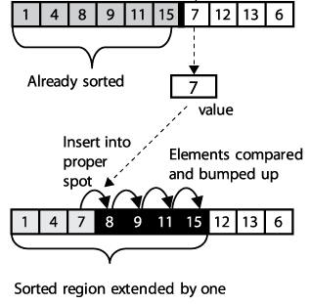

Question 1
The worst case for Insertion Sort occurs when the keys are initially in decreasing order. Suppose the performance of Insertion Sort is measured by the total number of comparisons between array elements (not counting the number of swaps). Show at least two other initial arrangements of keys that are also worst cases for Insertion Sort.

Slide 17
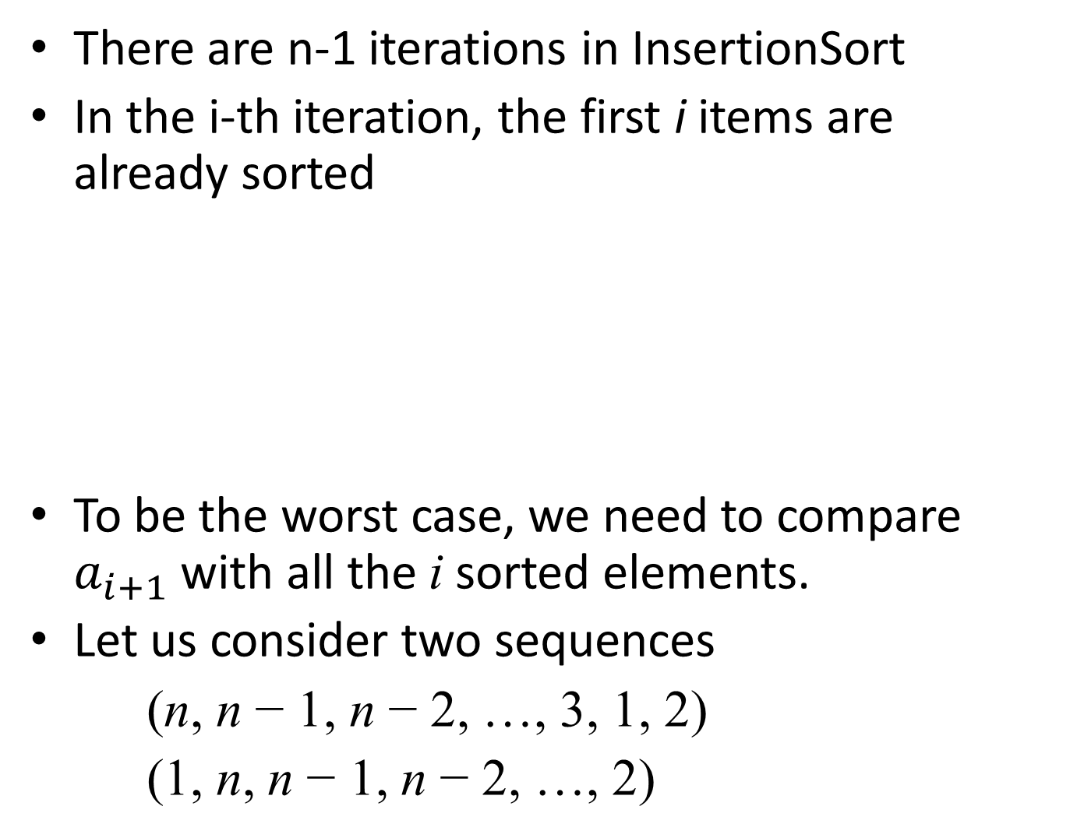
There are n-1 iterations in InsertionSort
In the i-th iteration, the first i items are already sorted
To be the worst case, we need to compare $a_{i+1}$ with all the i sorted elements.
Let us consider two sequences
(n, n − 1, n − 2, …, 3, 1, 2)
(1, n, n − 1, n − 2, …, 2)
 |  |  |  |  |  | $$a_{i+1}$$
Already sorted

Slide 18
(n, n − 1, n − 2, …, 3, 1, 2)
The same as the known worst case except for the last 2 elements
The (n-2)-th iteration: (n-2) comparisons and (n-2) swaps
The (n-1)-th iteration: (n-1) comparisons and (n-2) swaps
3 | 4 | … |  |  |  | n-1 | n | 1 | 2
Already sorted
1 | 3 | … |  |  |  |  | n-1 | n | 2
Already sorted
Total number of comparisons = 1+2+…+(n-1)=(n-1)n/2

Slide 19
(1, n, n − 1, n − 2, …, 2)
The 1-st iteration: 1 comparison and 0 swaps
The i-th iteration: i comparisons and (i-1) swaps
The (n-1)-th iteration: (n-1) comparisons and (n-2) swaps
1 | n | … |  |  |  |  |  | 3 | 2
Already sorted
1 | n-i+2 | … |  | n-1 | n | n-i+1 | n-i | … … | 2
Already sorted
1 | 3 | … |  |  |  |  | n-1 | n | 2
Already sorted
Total number of comparisons = 1+2+…+(n-1)=(n-1)n/2

Slide 20
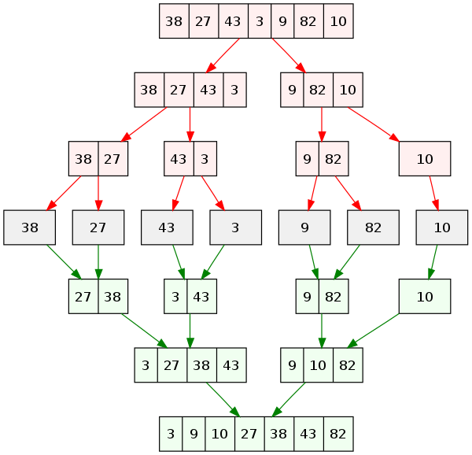
Question 3
Show how MergeSort sorts each of the arrays below and give the number of comparisons among array elements in sorting each array.
An example of merge sort. First divide the list into the smallest unit (1 element), then compare each element with the adjacent list to sort and merge the two adjacent lists. Finally all the elements are sorted and merged.

Slide 21
Merge two already-sorted arrays
3 cases to consider
Case 1: a < b, increase i1
a
c
b
d
i1
i2
a
c
b
d
i1
i2

Slide 22
Merge two already-sorted arrays
Case 2: a > b, right-shift the first array, insert b, and increase i2
a
c
b
d
i1
i2
b
a
c
d
i1
i2

Slide 23
Merge two already-sorted arrays
Case 3: a = b, right-shift the first array, insert b, and increase i1 and i2
a
c
b
d
i1
i2
a
b
c
d
i1
i2

Slide 24
Question 3
Show how MergeSort sorts each of the arrays below and give the number of comparisons among array elements in sorting each array.
(1) 14 40 31 28 3 15 17 51
Ans: The array is first divided into two equal parts
Each part is then sorted by MergeSort. The process begins by dividing each part into equal parts
and then each of these parts into equal parts
This subdivision process now ends because each part contains only one item.
14
40
31
28
3
15
17
51
14
40
31
28
3
15
17
51
14
40
31
28
3
15
17
51

Slide 25
Each pair is then merged
Each of these pairs is then merged
Finally these pairs are merged
to obtain the sorted array. Totally, it takes 4 + 5 + 7 = 16 comparisons.
14
40
31
28
3
15
17
51
4 comparisons required to reach this position
14
40
28
31
3
15
17
51
5 comparisons required to reach this position
14
28
31
40
3
15
17
51
7 comparisons required to reach this position
3
14
15
17
28
31
40
51

Slide 26
Merge two already-sorted arrays
14 > 3 case 2, right-shift the first array, insert b, and increase i2
14
28
31
40
3
15
17
51
i1
i2
3
14
28
31
40
15
17
51
i1
i2

Slide 27
14 < 15 case 1, increase i1
3
14
28
31
40
15
17
51
i1
i2
3
14
28
31
40
15
17
51
i1
i2

Slide 28
28 >15 case 2, right-shift the first array, insert 15 and increase i2
3
14
28
31
40
15
17
51
i1
i2
3
14
15
28
31
40
17
51
i1
i2

Slide 29
28 >17 case 2, right-shift the first array, insert 17 and increase i2
3
14
15
28
31
40
17
51
i1
i2
3
14
15
17
28
31
40
51
i1
i2

Slide 30
28 < 51 case 1, increase i1
3
14
15
17
28
31
40
51
i1
i2
3
14
15
17
28
31
40
51
i1
i2

Slide 31
31 < 51 case 1, increase i1
3
14
15
17
28
31
40
51
i1
i2
3
14
15
17
28
31
40
51
I1
i2

Slide 32
40 < 51 case 1, increase i1
Since the first array is exhausted, we stop merging
In total, there are 7 comparisons to merge the two arrays
3
14
15
17
28
31
40
51
I1
i2
3
14
15
17
28
31
40
51
i2

Slide 33
Question 3
Show how MergeSort sorts each of the arrays below and give the number of comparisons among array elements in sorting each array.
(2) 23 23 23 23 23 23 23 23
(2) Ans: The array is first divided into two equal parts
Each part is then sorted by mergesort. The process begins by dividing each part into equal parts
and then each of these parts into equal parts
This subdivision process now ends because each part contains only one item.
23
23
23
23
23
23
23
23
23
23
23
23
23
23
23
23
23
23
23
23
23
23
23
23

Slide 34
Each pair is then merged
Each of these pairs is then merged
Finally these pairs are merged
to obtain the sorted array. Totally, it takes 4 + 4 + 4 = 12 comparisons.
23
23
23
23
23
23
23
23
23
23
23
23
23
23
23
23
4 comparisons
23
23
23
23
23
23
23
23
4 comparisons
23
23
23
23
23
23
23
23
4 comparisons

Slide 35
23 =23 case 3, right-shift, insert and increase i1 & i2
23
23
23
23
23
23
23
23
i1
i2
23
23
23
23
23
23
23
23
i1
i2

Slide 36
23 =23 case 3, right-shift, insert and increase i1 & i2
23
23
23
23
23
23
23
23
i1
i2
23
23
23
23
23
23
23
23
i1
i2

Slide 37
23 =23 case 3, right-shift, insert and increase i1 & i2
23
23
23
23
23
23
23
23
i1
i2
23
23
23
23
23
23
23
23
i1
i2

Slide 38
23 =23 case 3, right-shift, insert and increase i1 & i2
Since both arrays are exhausted, we stop merging
In total, there are 4 comparisons
23
23
23
23
23
23
23
23
i1
i2
23
23
23
23
23
23
23
23

